Slide 1


Version 2.0 May 2024

Slide 2

Agenda
Financial Planning
PCS Considerations
  Before Your Move
  During Your Move
  After You Arrive
Allowances and Entitlements
Summary and Resources

Slide 3
Financial Planning
3

Slide 4
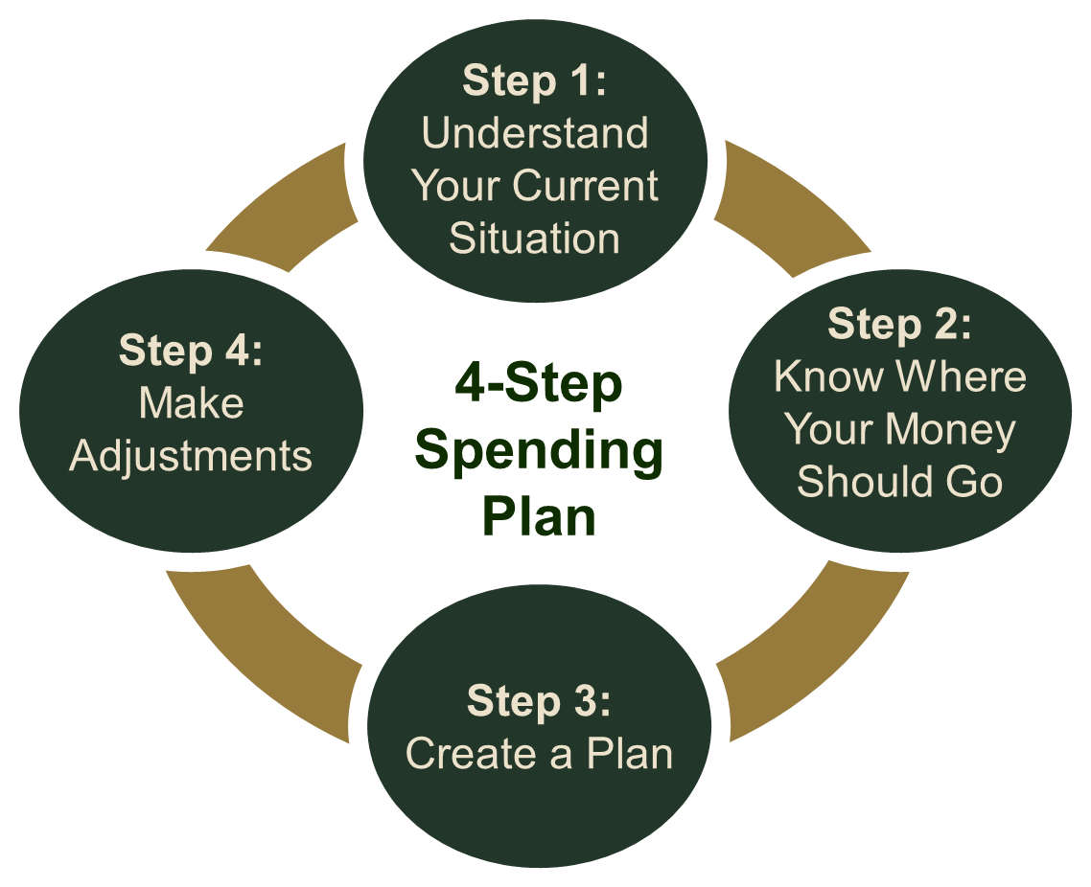
Create / Manage a Spending Plan

Slide 5
Estimate Changes to Income
Basic Allowance for Housing (BAH)
Overseas Housing Allowance (OHA)
Cost of Living Allowance (COLA)
Family Separation Allowance (FSA)
Special and Incentive Pays
Spousal Income
Federal Assistance Programs

Slide 6
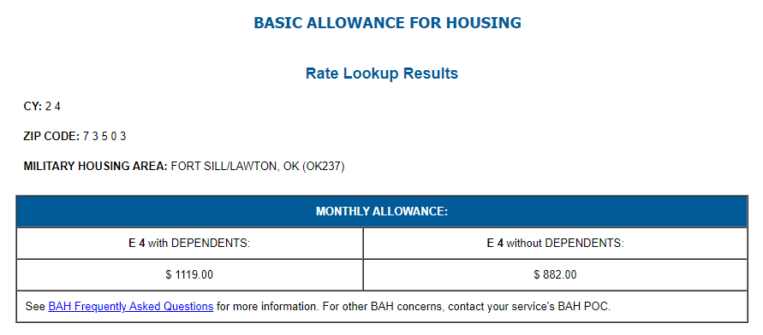
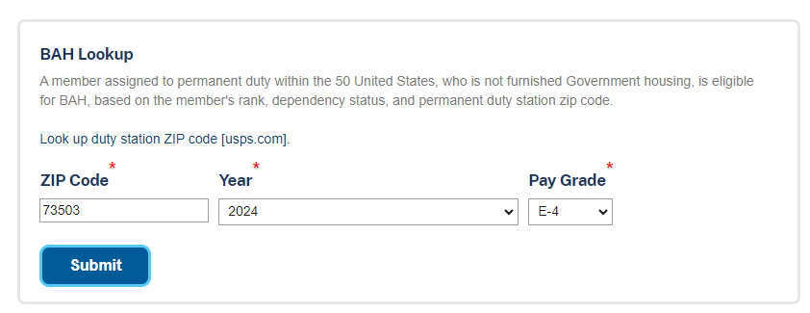
Basic Allowance for Housing (BAH) Calculator
Example:
SPC Jones is married with dependents. They are stationed at Fort Sill, OK and will receive $1119 in BAH for 2024.
Visit: https://www.travel.dod.mil/Allowances/Basic-Allowance-for-Housing/BAH-Rate-Lookup/

Slide 7

Estimate Changes to Expenses
Housing
Food
Transportation
Health
Personal and Family
Other

Slide 8



Health and Dental Insurance
TRICARE or US Family Health Plan
TRICARE Dental Program
Federal Employees Dental and Vision Insurance Program
Coordinate TRICARE and any Civilian Insurance
Notes:
Image sources:
https://www.pexels.com/photo/baby-in-blue-shorts-lying-on-white-fur-textile-3341187/
Stock image from PPT
https://www.pexels.com/photo/woman-carrying-baby-3259629/

Slide 9



Protect Your Credit
Notify financial institutions
Set up automatic payments
Check your credit
Enroll in free credit monitoring
Update your address
FREE reports at AnnualCreditReport.com

Slide 10

Manage Debt
Debt destroyer strategies
  Snowball
  Avalanche
Major purchases
  Housing
  Vehicles

Slide 11
PCS Considerations

Slide 12

Before Your Move – Part 1
Household Goods (HHG) and Personally Procured Move (PPM)
Housing
  House hunting
  Moving out
  On-post housing
  OCONUS housing
Property Insurance
Weight Limitations
Review and Update Policies

Slide 13
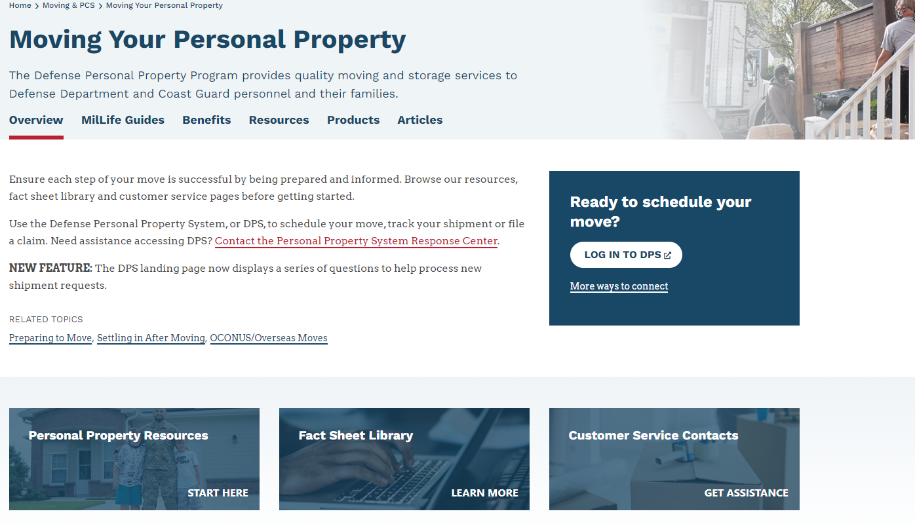
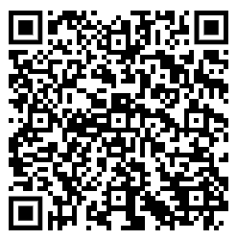
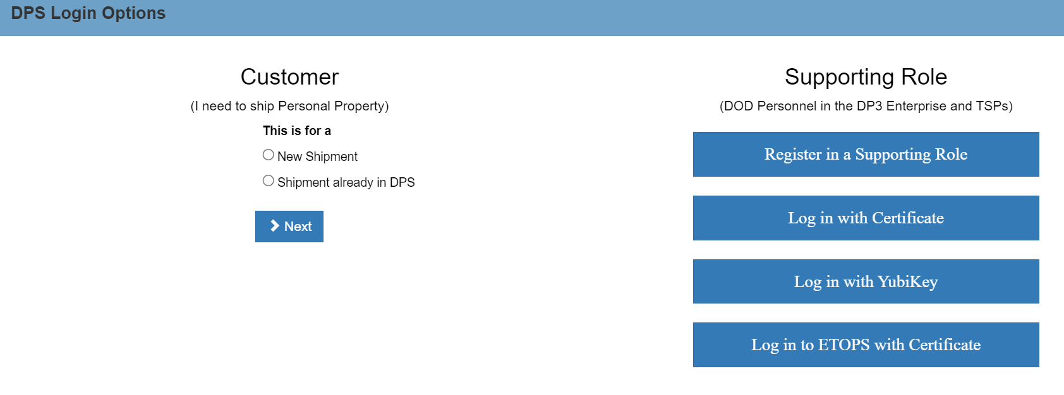
Before Your Move – Part 2
Visit: www.militaryonesource.mil/moving-pcs or your Travel Management Office for more information.

Slide 14


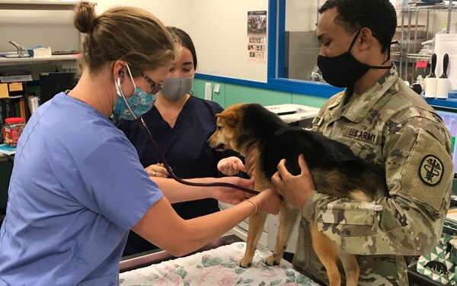


Before Your Move – Part 3
SCRA
Childcare
Vehicles
Pets
Passports

Slide 15
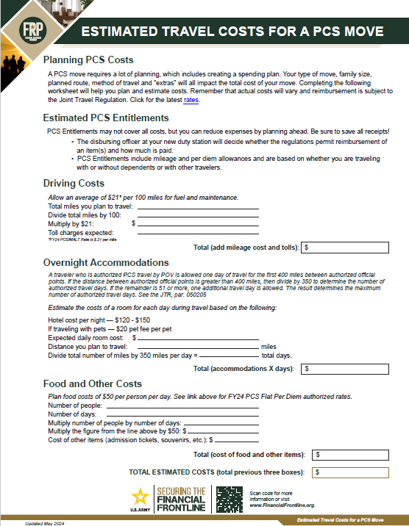
During Your Move
Estimated Travel Costs for a PCS Move Worksheet
Tax Considerations
Visit www.travel.dod.mil/

Slide 16

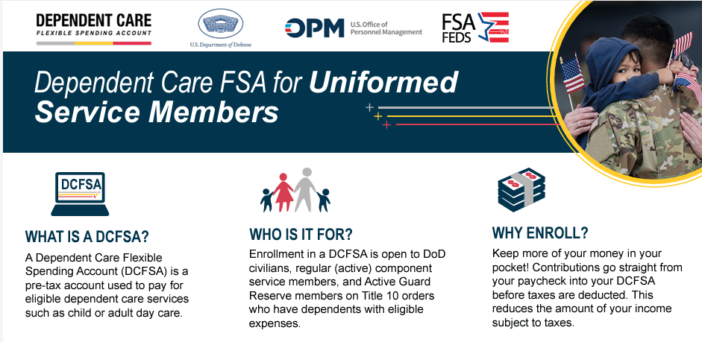





After You Arrive
Initial Expenses
DCFSA
Spouse Employment
State Residency
Childcare

Slide 17
Allowances and Entitlements

Slide 18
Travel Pay and Allowances
Pay | Advance Eligible | Purpose
Monetary Allowance in Lieu of Transportation | Yes, If no GTCC | Offset driving costs
PCS Per diem | Yes, If no GTCC | Cover lodging, meals & incidentals
Dislocation Allowance | Yes | Partially reimburses for expenses incurred (i.e., deposits, first and last month rent, unexpected moving costs, etc.)
Temporary Lodging Expense | No | Partially covers lodging and meal expenses while in temporary lodging (CONUS)
Pet Reimbursement | No | Reimbursement for costs related to the relocation of one household pet due to PCS
Overseas Housing Allowance | No | Offset housing and living expenses (Location-Specific)
Move-in Housing Allowance
Temporary Lodging Allowance
Cost of Living Allowance

Slide 19

PCS Pay Resources
Government Travel Charge Card (GTCC)
Advance on:
  Regular pay
  Basic Allowance for Housing (BAH)
  Dislocation Allowance (DLA)
Army Emergency Relief

Slide 20

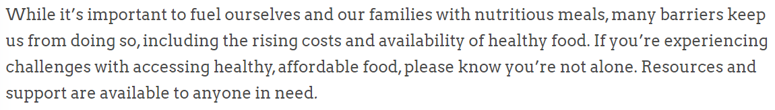








Food Security Resources and Support Programs
Learn about more resources here:
SNAP
BNA
WIC
Family Support Center
Financial Counselor
Army Emergency Relief
MilLife Guide
YOU ARE NOT ALONE
Notes:
Image sources:
https://www.pexels.com/photo/a-photo-of-a-family-walking-in-pedestrian-lane-3662910/
https://www.pexels.com/photo/person-holding-baby-s-hand-2721581/

Slide 21
Summary and Resources

Slide 22
Summary
Congratulations on your upcoming move to your next duty station!
Along with new adventure opportunities, a Permanent Change of Station can add many additional expenses. Preparation and planning can help alleviate the stress of spending more than you can afford.
Let’s wrap up all of the topics we talked about today:
  Financial Planning
  PCS Considerations
    Before Your Move
    During Your Move
    After You Arrive
  Allowances and Entitlements

Slide 23



Resources

Slide 24
Thank You!
The appearance of U.S. Department of Defense (DoD) visual information does not imply or constitute DoD endorsement.

